Slide 1
SOAP Testing

Slide 2
What is a Webservice?
Web services are self-contained, modular, distributed, dynamic applications that can be described, published, located, or invoked over the network to create products, processes, and supply chains
‘We can use many in different combinations to do different things’
It is both platform and language independent.

Slide 3
What is a Webservice?
A web service is a collection of open protocols and standards used for exchanging data between applications or systems. Software applications written in various programming languages and running on various platforms can use web services to exchange data over computer networks like the Internet in a manner similar to inter-process communication on a single computer

Slide 4
Why Webservices?
Exposing the Existing Function on the network
A web service is a unit of managed code that can be remotely invoked using HTTP, that is, it can be activated using HTTP requests. Web services allows you to expose the functionality of your existing code over the network. Once it is exposed on the network, other application can use the functionality of your program

Slide 5
Why Webservices?
Interoperability
Web services allow various applications to talk to each other and share data and services among themselves. Other applications can also use the web services. For example, a VB or .NET application can talk to Java web services and vice versa. Web services are used to make the application platform and technology independent.

Slide 6
Why Webservices?
.Standardized Protocol
Web services use standardized industry standard protocol for the communication. We use well-defined protocols in the web services protocol stack. This standardization of protocol stack gives the business many advantages such as a wide range of choices, reduction in the cost due to competition, and increase in the quality.
Remember Webservices are aimed at programs communicating so this standard protocol is very important.

Slide 7
Why Webservices?
Low Cost Communication
Web services use SOAP over HTTP protocol, so you can use your existing low-cost internet for implementing web services. This solution is much less costly compared to proprietary solutions like EDI/B2B. Besides SOAP over HTTP, web services can also be implemented on other reliable transport mechanisms like FTP.

Slide 8
Looking at SOAP

Slide 9
What is SOAP?
SOAP is an acronym for Simple Object Access Protocol
It is an XML-based messaging protocol for exchanging information among computers
SOAP is a communication protocol designed to communicate via Internet.
SOAP provides data transport for Web services.
SOAP can exchange complete documents or call a remote procedure.
SOAP is platform- and language-independent.
SOAP is the XML way of defining what information is sent and how
WSDL is XML based language which is used to describe the services offered by the web service.

Slide 10
SOAP
SOAP and REST are very similar, but they are different.
A SOAP Message is an ordinary XML document that contains up to 4 elements
- Envelope
- Header
- Body
- Fault.

Slide 11
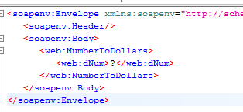
SOAP

Slide 12
SOAP
Envelope (Mandatory)
- Defines the start and the end of the message
Header (Optional)
- Used in processing the message

Slide 13
SOAP
Body (Mandatory)
- Actual message of the XML
Fault (Optional)
- This element provides information about errors that occurred whilst processing the message

Slide 14
Download and Using SOAPUI
SOAPUI is a GUI that allows us to send SOAP requests.
It has a free and a Pro version with different functionality.
We will have to modify the XML document in which we send our message.

Slide 15
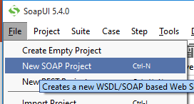
By Clicking File you can choose to make a new SOAP Project
Download and Using SOAPUI

Slide 16
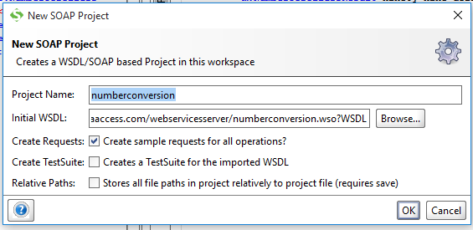
Download and Using SOAPUI
Name your project
For this example and subsequent practice we will be using the number converter WSDL
If this is done correctly requests will be populated on the left hand side of the screen.

Slide 17
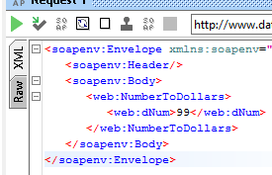
Download and Using SOAPUI
Double click the Request to access it.
Change the ‘?’ to a number.
Use the green arrow to run the SOAP request and to see the result.

Slide 18
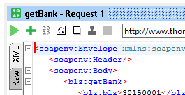
Download and Using SOAPUI
Once you have set up your SOAP request within a SOAP Project, you can use the tick mark to add this request to a Test Case, and then to a Test Suite.
By accessing the Request within the Test Suite you can use the Green Plus icon to add an assertion.

Slide 19
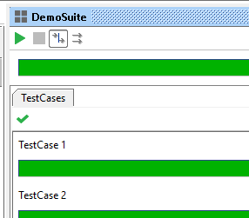
Download and Using SOAPUI
By double clicking the Test Suite you have created you can run the test cases that are assigned to it.

Slide 20
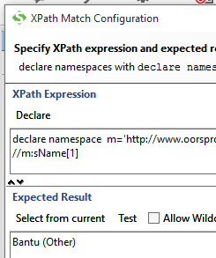
Further Assertions
You can add more precise assertions to your requests by making use of Xpaths.
For example:
Notes:
Tip: Click the Declare button to automatically generate the namespace.

Slide 21
